Slide 1
CH5650 – Term paper PREDICTION OF GLASS TRANSITION TEMPERATURE OF (METH) ACRYLIC POLYMERS CONTAINING PHENYL GROUPS BY RECURSIVE NEURAL NETWORKS
M Bharathi Mozhian
ch18b044

Slide 2
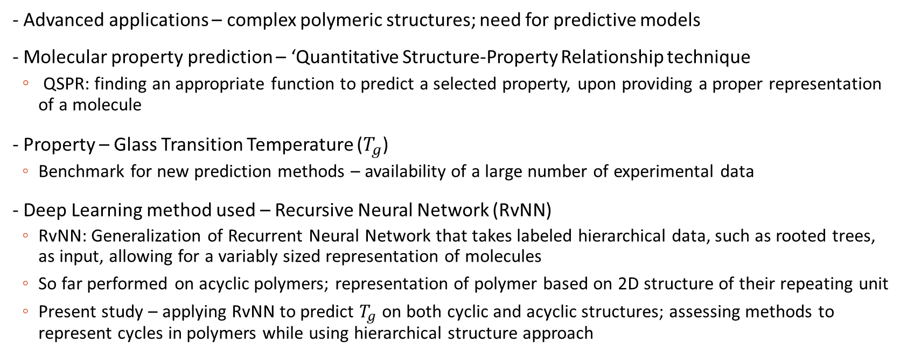
ABOUT THE PAPER
- Advanced applications – complex polymeric structures; need for predictive models
- Molecular property prediction – ‘Quantitative Structure-Property Relationship technique
QSPR: finding an appropriate function to predict a selected property, upon providing a proper representation of a molecule
- Property – Glass Transition Temperature ($T_{g}$)
Benchmark for new prediction methods – availability of a large number of experimental data
- Deep Learning method used – Recursive Neural Network (RvNN)
RvNN: Generalization of Recurrent Neural Network that takes labeled hierarchical data, such as rooted trees, as input, allowing for a variably sized representation of molecules
So far performed on acyclic polymers; representation of polymer based on 2D structure of their repeating unit
Present study – applying RvNN to predict $T_{g}$ on both cyclic and acyclic structures; assessing methods to represent cycles in polymers while using hierarchical structure approach

Slide 3
METHODOLOGY
Recursive Neural Networks:
RvNNs generalize RNNs; learn hierarchical models because of tree structure as opposed to RNNs (sequential data)
Number of children for each node is fixed - perform recursive operations & use same weights across the steps
To combine child nodes & produce the parent nodes, each child-parent connection has a weight matrix
Similar children share the same weights; for eg: in binary tree, all left children nodes share one weight matrix & all right children share another weight matrix
In addition, an initial weight matrix (V) required to calculate the hidden state for each raw input
Labels attached to each vertex; set of label symbols depends upon the devised chemical groups; chemical symbols represented by numerical vector labels
RvNN visits & encodes tree vertex-by-vertex through a recursive process; the code is then mapped to output property value by the same RvNN model
Recursive Cascade Correlation is used - neural Hidden Units (HU) progressively added until errors are below tolerance

Slide 4
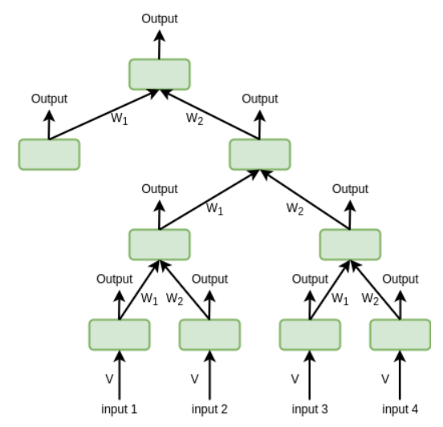
METHODOLOGY
Recursive Neural Network

Slide 5
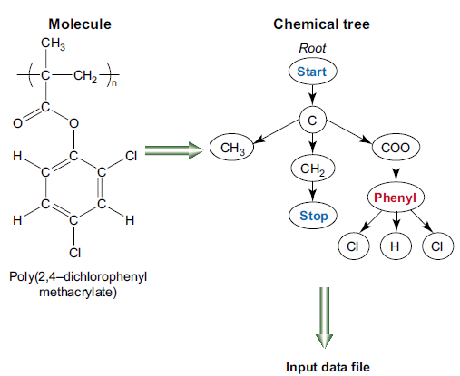
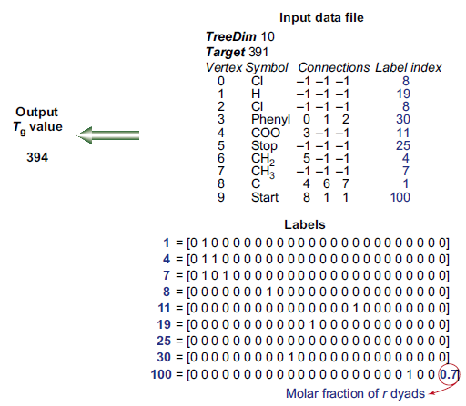
METHODOLOGY

Slide 6
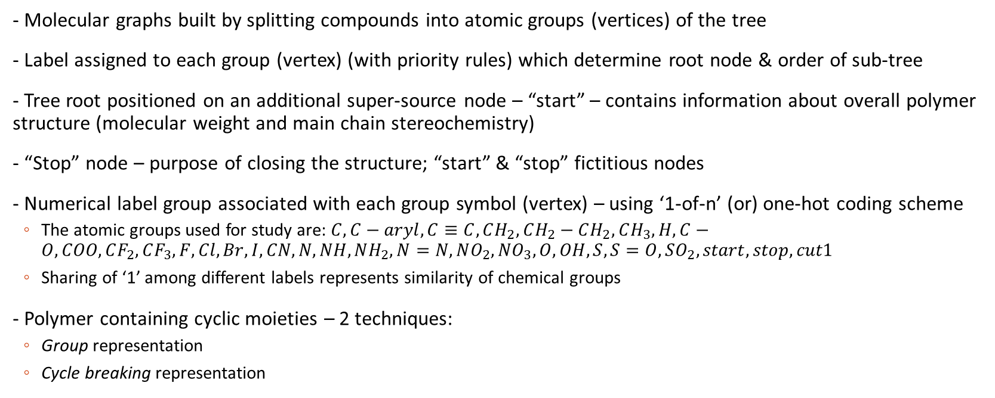
MOLECULAR REPRESENTATION
- Molecular graphs built by splitting compounds into atomic groups (vertices) of the tree
- Label assigned to each group (vertex) (with priority rules) which determine root node & order of sub-tree
- Tree root positioned on an additional super-source node – “start” – contains information about overall polymer structure (molecular weight and main chain stereochemistry)
- “Stop” node – purpose of closing the structure; “start” & “stop” fictitious nodes
- Numerical label group associated with each group symbol (vertex) – using ‘1-of-n’ (or) one-hot coding scheme
The atomic groups used for study are: $C, C−aryl, C≡C, CH_{2}, CH_{2}−CH_{2}, CH_{3}, H, C−O, COO, CF_{2}, CF_{3}, F, Cl, Br, I, CN, N, NH, NH_{2}, N=N, NO_{2}, NO_{3}, O, OH, S, S=O, SO_{2}, start, stop, cut1$
Sharing of ‘1’ among different labels represents similarity of chemical groups
- Polymer containing cyclic moieties – 2 techniques:
Group representation
Cycle breaking representation

Slide 7
MOLECULAR REPRESENTATION
Group:
- Associating each cyclic structure to a molecular vertex
- In dataset used in the present study, Phenyl group is the only cyclic structure
- Phenyl group carbons are numbered as follows:
Number one for carbon atom attached to polymer structure
Remaining carbon atoms are numbered consecutively clockwise or anticlockwise by allotting least possible number to the substituted carbon atoms
In dataset, only monosubstituted and disubstituted phenyl groups – ortho, meta & para positions (positions 2-4)
C atoms in positions 5 & 6 always H atoms – hence not included as child nodes
Phenyl group has 3 child nodes – substitute atoms in ortho, meta & para positions
Out-degree = 3 for phenyl group
- Advantage: simplicity and computational ease for RvNN
- Disadvantage: enough sampling in data required; applicable only for specialized datasets

Slide 8
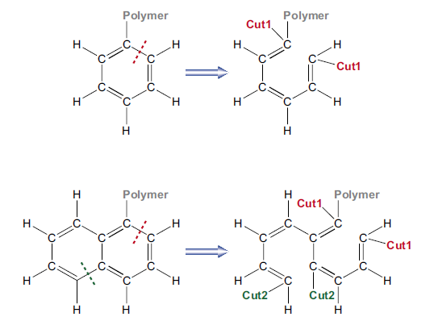
MOLECULAR REPRESENTATION
Cycle-breaking:
- Deriving connected hierarchical structure directly by breaking a bond in cyclic groups
- Topological information of maintained - occurrence of cyclic groups in original graph
- Resulting structure written as a tree after placing a ‘‘cut1’’ group at both sides of the broken bond
- Atoms connected by same broken bond are matched by identical labels
- Disadvantage: leads to deeper trees, computational difficulty
- Advantage: generality; allows for dealing with any cyclic structure independent of its sampling in dataset because its fragments (acyclic components) are adequately represented in the data

Slide 9
MOLECULAR REPRESENTATION
Representation Uniqueness:
- Which bond to cut in cycle-breaking? Which order to be given to sub-trees?
- Unique SMILES (Simplified Molecular Entry Line System) & InChI (International Chemical Identifier)
- Neither method supports explicit polymer representation models
- Tackled by artificial addition of long aliphatic chain to tree root that is chosen
‘start’ becomes aliphatic chain

Slide 10
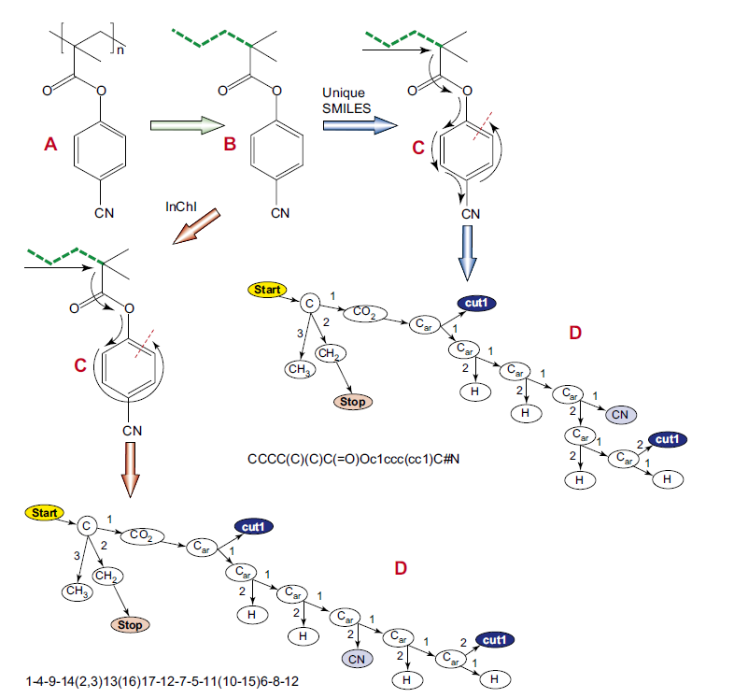
MOLECULAR REPRESENTATION
Representation Uniqueness:

Slide 11
EXPERIMENTS
Five experiments were performed; In Exp. 1 the benzene rings were described through the group representation, in Exps. 2-5 through the cycle breaking one
- Exp. 1 - group representation for the cyclic part, our priority rules for the linear one
- Exp. 2 - Unique SMILES for the cyclic part, our priority rules for the linear one
- Exp. 3 - Unique SMILES for the whole compound
- Exp. 4 - InChI for the cyclic part, our priority rules for the linear one
- Exp. 5 - InChI for the whole compound

Slide 12
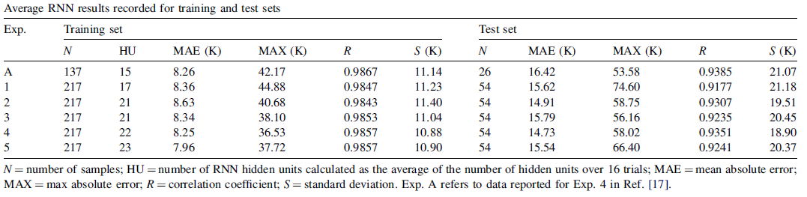

RESULTS
- Exp. A – RvNN on restricted data set without cyclic structures reported for comparison
- Exp A. carried with different molecular fragmentations; fragment compressions such as 2 consecutive $"CH_{2}"$ into $"CH_{2}−CH_{2}$” and $"C=O“$ & $"O“$ into $"COO“$ reduced computational load by 13 hidden units

Slide 13
RESULTS & CONCLUSIONS
- Results of the experiments reported in the study comparable to that obtained on data containing only acyclic compounds
- Shows that inclusion of cyclic moieties in a RNN-QSPR study is feasible and does not affect predictive accuracy
- No comparable difference in the error values and the predicted outputs between different representation methods employed
- Shows that RNN offers flexibility in choosing molecular representation; upto user to balance between structure detail and sampling requirements
- Group method suited for homogenous and specialized datasets (of cyclic structures)
- Cycle breaking method offers possibility of providing good results with larger variety of cyclic moieties with poor sampling

Slide 14
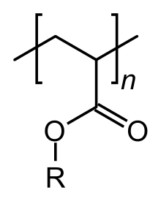
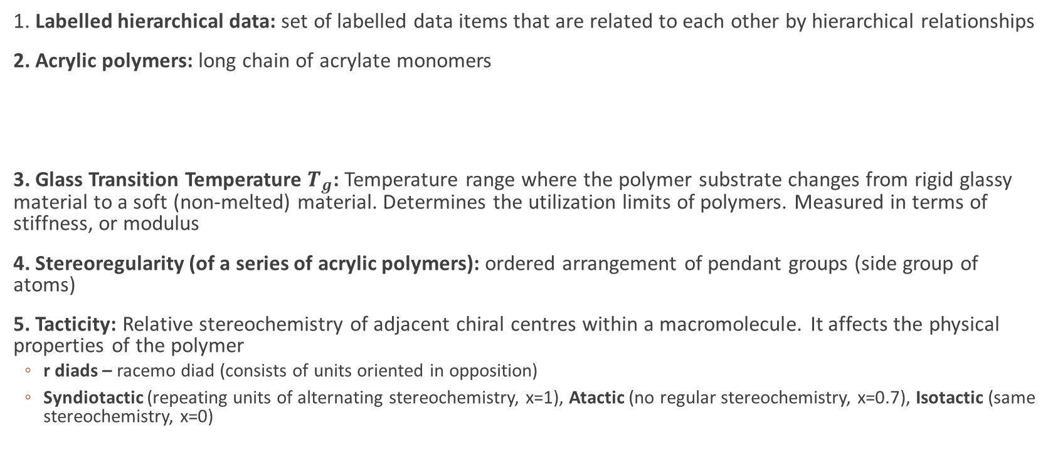
TERMINOLOGY
1. Labelled hierarchical data: set of labelled data items that are related to each other by hierarchical relationships
2. Acrylic polymers: long chain of acrylate monomers
3. Glass Transition Temperature $T_{g}$: Temperature range where the polymer substrate changes from rigid glassy material to a soft (non-melted) material. Determines the utilization limits of polymers. Measured in terms of stiffness, or modulus
4. Stereoregularity (of a series of acrylic polymers): ordered arrangement of pendant groups (side group of atoms)
5. Tacticity: Relative stereochemistry of adjacent chiral centres within a macromolecule. It affects the physical properties of the polymer
r diads – racemo diad (consists of units oriented in opposition)
Syndiotactic (repeating units of alternating stereochemistry, x=1), Atactic (no regular stereochemistry, x=0.7), Isotactic (same stereochemistry, x=0)

